Slide 1
The Institute and the Future of the Spectrum
Nikolaos Digelidis,
Professor & President of the SITL

Slide 2
The Spectrum around the world
So far…
More than 55 years of history in pedagogy
More than 6,000 downloads of the book
More than 103 countries
More than 8 languages and 20 publications globally

Slide 3
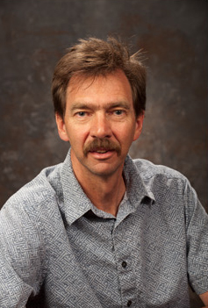
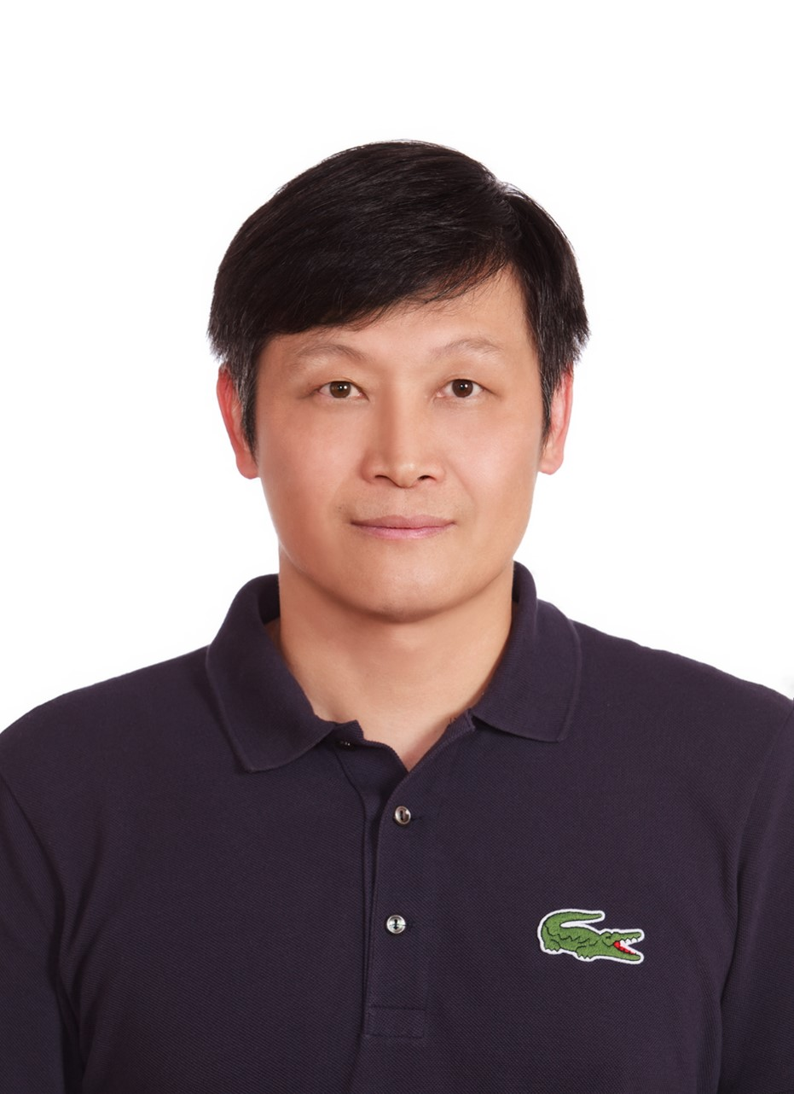
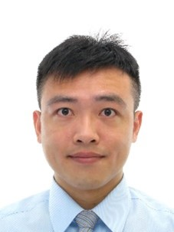
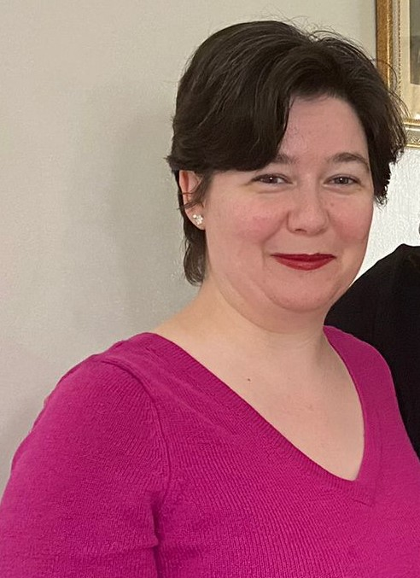
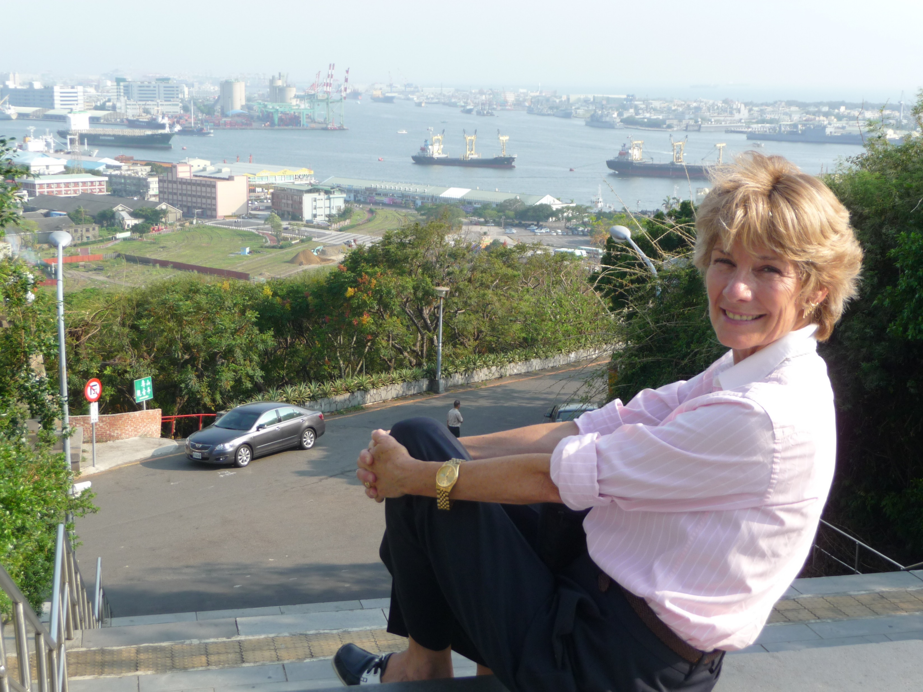
The Board
Nikolaos Digelidis
President
Robin Deng-Yau Shy
Vice President
Wei Feng-Min
Vice President
Autumn Rosencrantz
Secretary
Mark Byra
Treasurer
Sara Ashworth
Advisor

Slide 4
The Institute and its mission
The Mission of the Spectrum Institute for Teaching and Learning is to promote, enhance, disseminate, and propagate the Spectrum of Teaching Styles.

Slide 5
Purpose and implementation goals
The purpose of the SITL organization is to provide a center for people from around the world to come and work together in the common commitment of improving quality teaching and schooling
The SITL is committed to the betterment of humanity through its continuous research and pedagogical progression

Slide 6
Spectrum Institute for whom?
The Spectrum Institute for Teaching and Learning will provide a focus/center/means for:
Teachers
Teacher educators
Pedagogical scholars
Curriculum developers

Slide 7
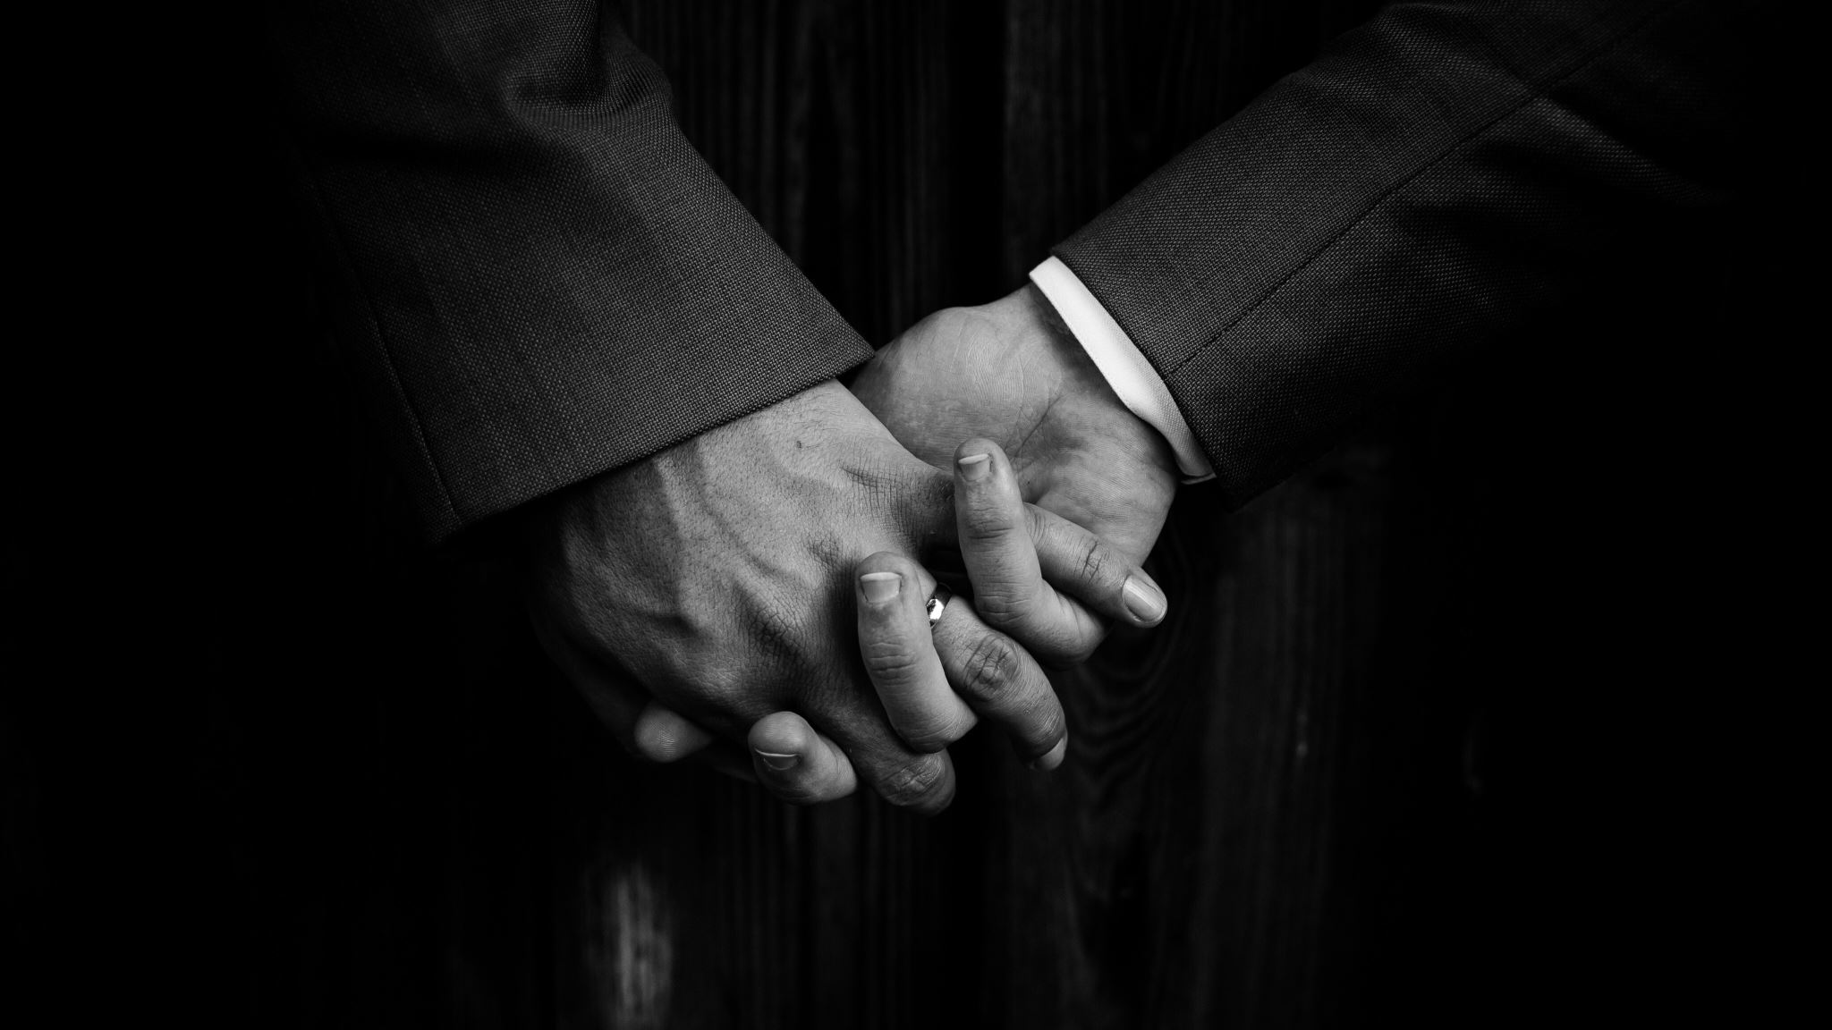
Together with you!

Slide 8
Our new Facebook page: A link that brings us together with colleagues around the world
https://www.facebook.com/thespectrumofteachingstyles

Slide 9
Funding and expanding
SITL would hope to expand the user base for Spectrum through a series of seminars, meetings, articles, workshops, etc., in many different languages with the objective of increasing the existing user base from 5.000 users to 20.000 users over the next 10 years.
In order to carry out this objective, SITL requires funding sources beyond the limited resources of its existing group adherents.
These funding sources could include government grants, foundation support, university partnerships, etc. – all of which require SITL to be a recognized not-for-profit organization with a valid exempt status

Slide 10
Promoting Spectrum Teaching

Slide 11
Workshops with Spectrum experts around the world

Slide 12
Promoting Spectrum Research

Slide 13
Grants and Awards
Master’s Degree Students: Current master’s degree student of at least second year standing
Doctoral Degree Students: Current doctoral degree student of at least second year standing
Early Career Researchers/Faculty: Up to three years post-doctoral degree completion
Later Career Researchers/Faculty: At least four years post-doctoral degree completion

Slide 14
We are looking forward for the moment we’ll be able to gather again

